Slide 1
Distributed Interactive Simulation (DIS) 101
Mark McCall
DIS PDG Chair
markmccall@sisostds.org

Slide 2
Overview
General DIS Overview
DIS History
DIS Documents
Key Definitions and Concepts
PDU Families
The Updated DIS Version 7 Standard
IEEE 1278 Update History
General standard improvements
PDU-specific improvements and new PDUs
Annexes

Slide 3
Distributed Interactive Simulation (DIS)
Distributed Interactive Simulation (DIS) :
Time and space coherent synthetic representation of world environments
Designed for linking the interactive, free-play activities of people in operational exercises
Synthetic environment is created through real-time exchange of data units between distributed, computationally autonomous simulation applications
Computational simulation entities may be present in one location or may be distributed geographically
DIS defines standard Protocol Data Units (PDUs)
Syntax (format) and semantics (rules) for data exchange and simulation interoperability
IEEE Std 1278.1-2012

Slide 4
DIS History
August 1989 – First DIS Workshop
Decided to develop DIS using SIMNET as core protocol
March 1993 – IEEE Std 1278 approved
Sept 1995 – IEEE Std 1278.1 revision approved
1997 – DIS Workshops replaced by SISO & SIWs
March 1998 – IEEE Std 1278.1a addendum approved
2002 – IEEE 1278.1/1a Reaffirmed

Slide 5
DIS Documentation Relationships
Distributed Interactive Simulation standards, recommended practices, and related documents
IEEE Std 1278.1- 2012
Standard for DIS
—
Application Protocols
IEEE 1278.2-1995
Standard for DIS — Communications Services and Protocols
IEEE 1278.3-1996
Rec. Prac. for DIS —
Exercise Mgt. and Feedback
IEEE 1278.4-1997
Rec. Prac. for DIS —
Verification, Validation, and Accreditation
SISO-REF-010 Enumerations for Simulation Interoperability

Slide 6
DIS Versions
1 - DIS PDU version 1.0 (May 92)
2 - IEEE Std 1278-1993
3 - DIS PDU version 2.0 - draft (May 93)
4 - DIS PDU version 2.0 - draft (Mar 94)
5 - IEEE Std 1278.1-1995
6 - IEEE Std 1278.1a-1998
7 - IEEE Std 1278.1-2012

Slide 7
Key DIS Concepts
No central computer controls the entire simulation exercise
Autonomous simulation applications are responsible for maintaining the state of one or more simulation entities
A standard protocol is used for communicating ground truth data
Changes in the state of an entity are communicated by its controlling simulation application
Perception of events or other entities is determined by the receiving application
Dead reckoning algorithms are used to reduce communications processing

Slide 8
Key DIS Definitions (1 of 5)
Simulation application:
Executing software on a host computer that models all or part of the representation of one or more simulation entities
Executing software on a host computer that models all or part of the world phenomena for the purpose of training or experimentation
Receives and processes information concerning entities created by peer simulation applications through the exchange of DIS PDUs
More than one simulation application may simultaneously execute on a host computer
IEEE Std 1278.1-2012

Slide 9
Key DIS Definitions (2 of 5)
Host Computer:
Computer that supports one or more simulation applications
Host computers participating in a simulation exercise are connected by network(s) including local area networks, wide area networks, radio frequency links, etc
IEEE Std 1278.1-2012

Slide 10
Key DIS Definitions (3 of 5)
Simulation entity:
A physical object in the synthetic environment that is created and controlled by a simulation application and affected by the exchange of DIS PDUs
It is possible that a simulation application may be controlling more than one simulation entity
IEEE Std 1278.1-2012

Slide 11
Key DIS Definitions (4 of 5)
Simulation exercise:
An exercise that consists of one or more interacting simulation applications
Simulations participating in the same simulation exercise share a common identifying number called the exercise identifier
Simulations utilize correlated representations of the synthetic environment collection and distribution of certain types of data which they operate
IEEE Std 1278.1-2012

Slide 12
Key DIS Definitions (5 of 5)
Simulation environment:
The operational environment surrounding the simulation entities
Includes terrain, atmospheric, and oceanographic information
Participants in the same DIS exercise will be using environment information that is adequately correlated for the type of exercise to be performed
IEEE Std 1278.1-2012

Slide 13
PDU Families
Entity information/interaction
Warfare
Logistics
Simulation Management
Distributed Emission Regeneration
Radio Communications
Entity Management
Minefield
Synthetic Environment
Simulation Management with Reliability
Live Entity
Non-Real Time protocol
Information Operations

Slide 14
PDU Families (Cont)
Entity information/interaction
Appearance of an entity
Location of an entity
Entity collisions
Attribute PDU (Version 7)
Warfare
Weapons
Expendables
Explosions
Fire/Detonate
Directed Energy (Version 7)
Entity Damage Status (Version 7)

Slide 15
PDU Families (Cont)
Logistics
Representation of logistics support
Request and Response
Resupply
Repair
Simulation Management
Centralized control of a simulation exercise
Start, restart, maintenance, shutdown, data collection, data distribution
Optional – used as required and supported

Slide 16
PDU Families (Cont)
Distributed Emission Regeneration
Simulation of emissions
Electromagnetic – Radar, IFF
Underwater Acoustics
Laser Designators
Emitting entity describes the emission
Sensing entity responsible for regeneration of emission at required fidelity
Radio Communications
Audio and Digital communications
Sending entity describes communications device
Sending entity provides the message
Receiving entities determine if they can receive the signal and determine what to do about the message
Tactical Data Links simulated using these PDUs

Slide 17
PDU Families (Cont)
Entity Management
Four alternative methods for managing entities
Entity aggregation for large scale exercises
Communication of state of aggregated entities
Transferring ownership of an entity
Hierarchical linkage of separately hosted entities
Minefield
Location of mines/minefields
Appearance of mines/minefields
Other pertinent details
Synthetic Environment
Process approach used to exchange information about smoke, contrails, dust, obscurants, toxic chemicals
Object approach used to exchange information about point, line, or areal objects in environment

Slide 18
PDU Families (Cont)
Simulation Management with Reliability
Uses simulation management PDUs
Specifies use of reliable communications
Optional – use as required and supported
Information Operations (Version 7)
Simulate the use of electronic warfare, computer network attack, military deception, etc
Influence or disrupt decision making
Predicted effects are transmitted
Perceived effects are reported

Slide 19
PDU Families (Cont)
Non-Real Time protocol
Most DIS exercises are human-in-the-loop and operate in real time
Defines how DIS PDUs can be in non-real time exercise
Live Entity Information/Interaction protocol
Designed for bandwidth-limited range interactions
Architectural changes to PDUs to conserve bandwidth

Slide 20
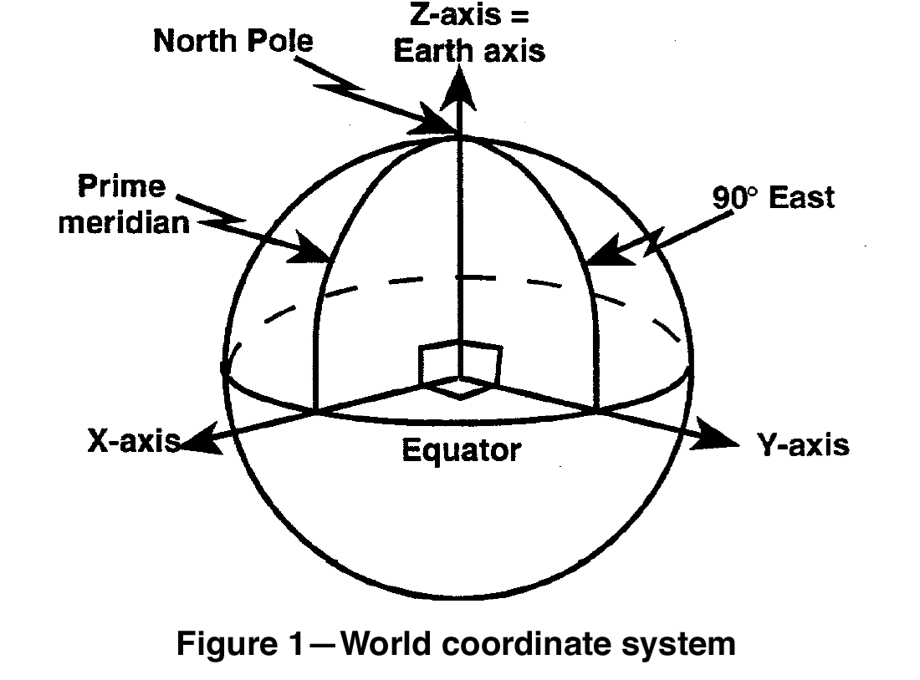
Entity Coordinates
Geocentric Coordinates
Position and Orientation
WGS-84 elliptical Earth model
Units in meters and radians

Slide 21
Entity Type Identification
ENTITY TYPE RECORD
Entity Kind | 8 bit enumeration
Domain | 8 bit enumeration
Country | 16 bit enumeration
Category | 8 bit enumeration
Sub Category | 8 bit enumeration
Specific | 8 bit enumeration
Extra | 8 bit enumeration
Hierarchical designation of Entity Type
Enumerations are listed in SISO-REF-010
Over 13,000 entity types

Slide 22
Examples of Type Enumerations
 | Kind | Domain | Country | Category | Sub Category | Specific | Extra
F-15C | 1 | 2 | 225 | 1 | 5 | 3 | -
F-15E | 1 | 2 | 225 | 1 | 5 | 5 | -
MiG-27K | 1 | 2 | 222 | 2 | 1 | 2 | -
M1A2 Abrams | 1 | 1 | 225 | 1 | 1 | 3 | -
T-72B | 1 | 1 | 222 | 1 | 2 | 6 | -
D 98 York | 1 | 3 | 224 | 4 | 1 | 12 | -
Mk 44 torpedo | 2 | 7 | 225 | 1 | 9 | - | -

Slide 23
Entity Instance Identification
Combination of 3 numbers identify individual entities and objects
Exercises can assign site numbers, sites can assign sims at the site, sims can assign entity numbers
Site | 16-bit unsigned
Application | 16 bit unsigned
Entity | 16 bit unsigned

Slide 24
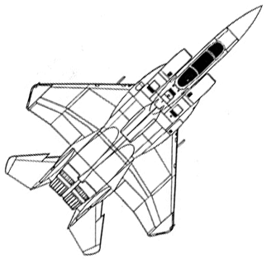
Dead Reckoning and Smoothing
Entity sends update when error > threshold
Receiver extrapolates between updates
Spatial jump at update is smoothed over
Green Line: Internal Model (“truth”)
Red Line: Dead Reckoned (extrapolated) Model
White Line: Smoothing Model

Slide 25
Overview
General DIS Overview
DIS History
DIS Documents
Key Definitions and Concepts
PDU Families
The Updated DIS Version 7 Standard
IEEE 1278 Update History
General standard improvements
PDU-specific improvements and new PDUs
Annexes

Slide 26
IEEE 1278.1 Update History
2003 – DIS Study Group formed under the SISO SAC
Identified approximately 100 Problem/Change Requests
Recommended revision of IEEE 1278 standards
2004 – DIS Product Development Group formed
Initial focus to combine and revise 1278.1 & 1278.1a
Problem/Change Requests and revision areas identified based on interest and willingness of PDG members to work on revision.
2005 – IEEE Project Authorization Request approved
4-year effort to revise and update standard
Dec 2012– Draft 17 published as IEEE Std 1278.1-2012

Slide 27
IEEE 1278.2, .3, .4 Update History
2007 – DIS PDG submitted Product Nomination for the revision of IEEE 1278.2
2007 – SISO SAC decides to reaffirm IEEE 1278.3/4 pending their replacement by IEEE 1730 series
2008 – IEEE Project Authorization Request approved revision of IEEE 1278.2
4-year effort to revise and update 1278.2
Extended to 31 Dec 2014

Slide 28
DIS V7 - Extensive clarifications
New and improved rules
Lessons learned from 15 years of use
New standard is 747 pages
The 1995 and 1998 standards combined were 330 pages
Even if you have no plans to use any of the new features, the new standard is still extremely useful

Slide 29
Compatibility with Version 5/6
Almost every change in the PDU formats and rules are backward compatible with Version 5/6 PDUs
Most changes are also forward compatible (i.e. Version 5 simulations can still make sense of Version 7 PDUs)
Use of former padding fields
New sims can add info, old sims ignore it

Slide 30
DIS Exercise Rules
The DIS Exercise section 4.2 has been expanded significantly
A comprehensive section covering simulations, objects, heartbeats, timeouts, thresholds, gateways and protocol version

Slide 31
Objects and Identifiers
Clearer definition of “object” and “entity”
Entities are objects that have an ESPDU
Other objects are usually attached to entities or are things such as environmental objects
Confusion on the 3rd number of the Site-App-Entity IDs is cleared up
Non-object IDs clarified
e.g. Simulation IDs, Request IDs

Slide 32
Variable Heartbeat Periods
Entity State default heartbeat periods now defined by entity kind, domain, and whether moving or stationary
Other PDU types have individual default heartbeat periods
Standard defines defaults
Exercises can set actual values
Provides flexibility and reduces the number of heartbeat updates

Slide 33
Protocol Version Rules
Lack of rules on use of Versions 5 or 6 led to confusion
Rules for interoperability between Version 5/6 and Version 7 are defined
Mixed version exercises are allowed
A single sim may issue both 5/6 and 7
Must obey rules of the version in the PDU, both sending and receiving

Slide 34
Transfer Ownership
The Transfer Control function has been renamed to Transfer Ownership
The Transfer Control Request PDU has been renamed the Transfer Ownership PDU
The entire Transfer Ownership function has been revised to improve its functionality
It is now closer to how TO has been done in actual simulations for many years

Slide 35
Time
Time requirements have been extensively clarified and revised
Absolute, relative, simulation time
Timestamp usage
Time synchronization
Absolute Time does not have to be synched to a GPS Time source, just to some source agreed to by the exercise
New 8 page Annex of additional info

Slide 36
Dead Reckoning
Dead Reckoning annex has been revised to clarify and correct technical details
Existing algorithms 1 to 9 are unchanged. Alternate algorithms 10 and 11 have been deleted.
Addition of a new quaternion method of rotational extrapolation

Slide 37
Protocol Extensibility
DIS now more easily customized
Corrects a weakness in the original standard
Backward compatibility maintained mostly
Variable Parameter Records
Entity State, Detonation
Standard Variable Records
Transmitter, IFF, DE Fire, Entity Damage, IO
Attribute PDU
Can extend all other PDUs
Or, info that doesn’t have a PDU

Slide 38
Variable Parameter Records
The Articulated/Attached Parts record in the Entity State and Detonation PDUs has been opened up for extension
Entity Separation VP Record
Parameter Type Designator | 8-bit enumeration
Reason for Separation | 8-bit enumeration
Pre-Entity Indicator | 8-bit enum
Padding | 8-bits unused
Parent Entity ID | 48-bit enum
Padding | 16-bits unused
Station Location | 32-bit enum
First 8 bits denotes record
Other 120 bits is definable
Still fixed at 128 bit length
3 new records so far
Several ideas for other appearance records

Slide 39
Standard Variable Specification Record
Number of Standard Variable Records (N) | 16-bit unsigned integer
Standard Variable record #1 | Record Type – 32-bit enumeration
 | Record Length – 16-bit unsigned integer (6+K₁+P₁)
 | Record-Specific Fields – K₁ octets
 | Padding to 64 bits – P₁ octets
o o o
Standard Variable record #N | Record Type – 32-bit enumeration
 | Record Length – 16-bit unsigned integer (6+K_{N}+P_{N})
 | Record-Specific Fields – K_{N} octets
 | Padding to 64 bits – P_{N} octets

Slide 40
Uses of Standard Variable Spec Record
Transmitter PDU – Variable Transmitter Parameters records
IFF PDU Layers 3, 4, 5 – IFF Data records
Directed Energy Fire PDU – DE records
Entity Damage Status PDU – Damage Description records
IO PDUs – IO records
Attribute PDU – Attribute records
All future PDUs to contain Std Var records

Slide 41
The Attribute PDU
Allows existing PDUs to be extended without breaking forward or backward compatibility
The PDU contains sets of Attribute records
Each set is tied to an entity or object
Attribute records are open format Standard Variable records
Not allowed to contain information that already exists in other PDUs
Otherwise, there would be confusion about which PDU to use

Slide 42
The Attribute PDU (cont)
A transient PDU can be extended by attaching an Attribute PDU to it
This is called Coupled Extension
Requires PDU Bundling
State PDUs can be extended by sending Attribute PDUS at any time
Or, the Attribute PDU can be coupled

Slide 43
PDU Bundling rules clarified
Improves network efficiency by allowing one or more PDUs to be concatenated in a UDP datagram
Bundling rules given in 1278.2
Tradeoff between delaying PDUs to build bigger bundles
Latency vs. network efficiency
Max size of bundle also explained

Slide 44
Maximum PDU Size
Max PDU size clarified to be 8K bytes
Original 1278.2 mentions 8K but didn’t have a clear rule
1400 bytes is still a good limit where possible
Network MTU is the guideline
Avoids fragmentation - more efficient transfer
8K size is available for large data sets or bundles

Slide 45
Expanded Weapons Support
Fire and Detonate PDUs now have better support for:
Expendables (IR flares, chaff)
Non-munition explosions such as kinetic weapon or secondary explosions (e.g. fuel tank)
Original Burst Descriptor record is now:
Munition Descriptor record (unchanged)
Expendable Descriptor record
Explosion Descriptor record for non-munition explosions

Slide 46
Entity Separation
Clarified and includes support for:
Multi-stage missile separation
Portraying submunitions
Variable Parameter records for Separation
Entity Type VP record
Separation VP record
Towed Decoys
Association VP record

Slide 47
Electromagnetic Emissions
Better description of radar beam parameters, scan volumes, phased array radar
Jammer field redefined to better support a wider range of multi-resolution simulations

Slide 48
Partial Updates for Emissions
Original standard was not clear if every system for an entity had to be included in every PDU update
It is now clear that this is not necessary
Systems can be spread across multiple PDUs
Can send only changed systems and beams
This potentially breaks forward and backward compatibility
However, the 1995 standard was ambiguous on this matter so compatibility is difficult regardless

Slide 49
IFF Mode 5/S
New layers in the IFF PDU
Layer 3 for Mode 5 IFF
Layer 4 for Mode S IFF
Layer 5 open for other IFF capabilities
All IFF record formats presently contained in the SISO-REF-010 Enumeration document have been moved into the standard
The requirements related to each IFF transponder and interrogator system type are clearly specified in a new Annex

Slide 50
Major Radio Simulation Changes
Extensive Transmitter PDU clarifications
Transmitter PDU heartbeats must be sent even if Power is off
Must contain all radio parameter settings
New annex for radio systems specifics
New basic and High Fidelity HAVE QUICK Radio records
SINCGARS and JTIDS/MIDS radio MP records moved from DIS Enumeration document
New Variable Transmitter Parameter (VTP) Record format
Minor forward compatible software change

Slide 51
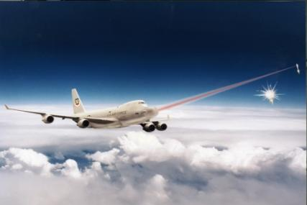
Five New PDUs
Directed Energy Weapons
Directed Energy Fire PDU
Entity Damage Status PDU
Information Operations
IO Action PDU
IO Report PDU
Attribute PDU
Adds extensibility to the DIS standard

Slide 52
Directed Energy Fire PDU
Supports high-fidelity directed energy engagements
Conveys detailed characteristics of the energy deposition
Type of weapon (e.g. Laser, Microwave)
Duration
Beam shape

Slide 53
Entity Damage Status PDU
Allows an entity to report high-fidelity damage details of themselves
Originally designed for directed energy weapons to help direct their fire
Opened up to communicate any type of damage

Slide 54
Information Operations
IO supports interoperability of simulated electronic warfare, computer network operations, military deception, and similar operations used to influence or disrupt enemy decision making
IO Action PDU can contain the predicted effects of an attack
The actual effects of an attack are communicated in IO report PDU

Slide 55
Annexes
Annex A Warfare. Additional requirements to support the warfare functional area
Annex B Specific Transponder and Interrogator Systems for IFF
Annex C Radio Systems. Details of specific radio systems
Annex D Objects. Details of object types and primary and secondary identifiers
Annex E Dead reckoning definitions and algorithms

Slide 56
Annexes (cont)
Annex F Heartbeats, Timeouts, Thresholds. Guidance on interoperability when some simulations have implemented the new entity timeout requirements and some have not.
Annex G Time Calculations and Uses. Additional information on time and its uses in a distributed simulation environment
Annex H Transfer Ownership. Detailed requirements for transfer ownership.
Annex I Articulated and Attached Parts

Slide 57
Questions

